Slide 1
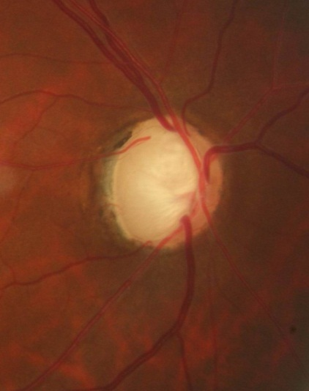
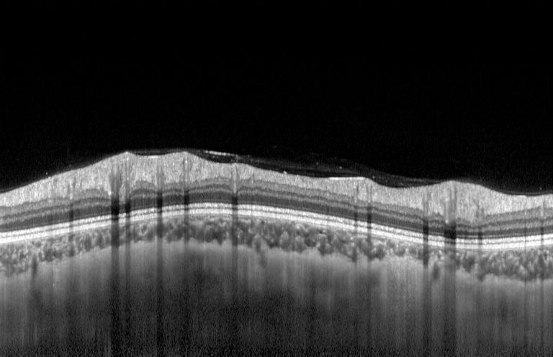
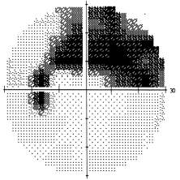
Multiple Modular tests
Fundus Photo
OCT
VF
Notes:
As we mentioned in the beginning, glaucoma Diagnosis mainly depends on VF ,OCT and fundus photo

Slide 2
24-2 or 30-2 VF tests
Two main data modules needed in our project
These are the most widely used mode in VF tests
Data from Zeiss HFA are preferred
Volumetric OCT scans
These are 3D OCT scans centered at the fovea or optic disc
Data from TOPCON swept source OCTs are preferred
Data from other devices such as Heidelberg, Zeiss, etc. are also acceptable.

Slide 3
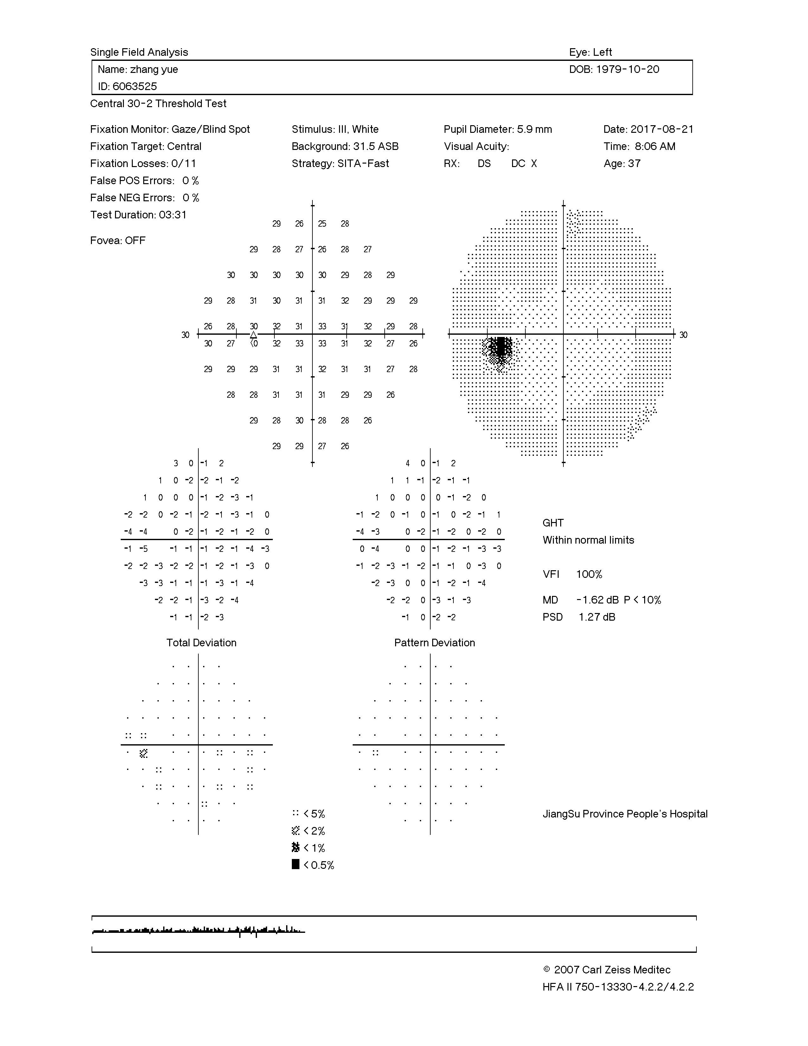
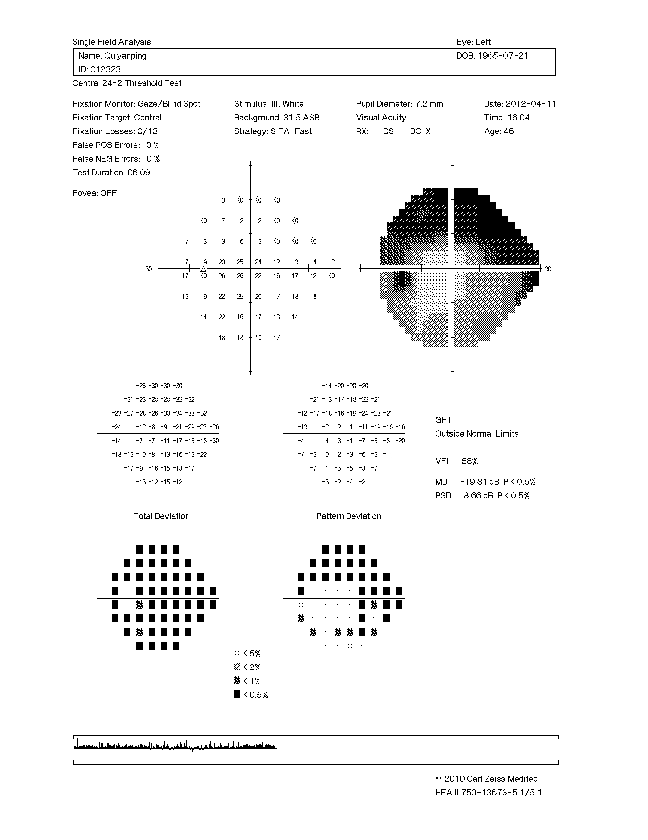
Reliability
Light sensitivity
PD number
PD number
PD plot
PD plot
30-2 VF
24-2 VF
Notes:
Here are examples of VF reports，PD plot presented as black dots in red square is what we usually read, indicated that there is a significant decrease in light sensitivity after adjusted by smaller pupil, age, and cataract. PD plot originates from the plot in orange, that’s is PD number.
Here are examples of VF reports. As you can see, it is composed several parts. Data in blue square indicates if the test result is reliable. Numbers in green xxxx stands for values of light sensitivity in different locations in VF. While doctors usually read the thins in red square, which is called pattern deviation plot. PD plot originates from the plot in orange. It shows if there is significant decrease in light sensitivity which is presented as black dots. The black dots are arranged in various patterns, some of them indicate existence of glaucoma.

Slide 4
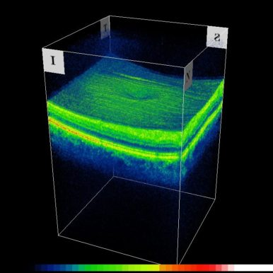
This is what we see on the built-in software of OCT devices.
This is what we see when you split the OCT file into b-scans.

